Slide 1
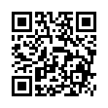

On optimal control and machine learning
Tutorial at the Workshop on New Frontiers in Learning, Control, and Dynamical Systems
Brandon Amos • Meta AI (FAIR) NYC
slides
github.com/bamos/presentations

Slide 2

Disclaimer
This is an introduction to optimal control for machine learning researchers
Perspective: a starting map of ideas rather than a comprehensive coverage
A tour through some of my favorite ideas, foundations, and recent papers
Will emphasize the engineering side — concepts most useful for building systems
Focus also on continuous control, but many concepts transfer to discrete settings
Notes:
These are huge fields. This talk is just my perspective to give an introduction and context around a few of my favorite topics to help frame ongoing discussions in the field.

Slide 3
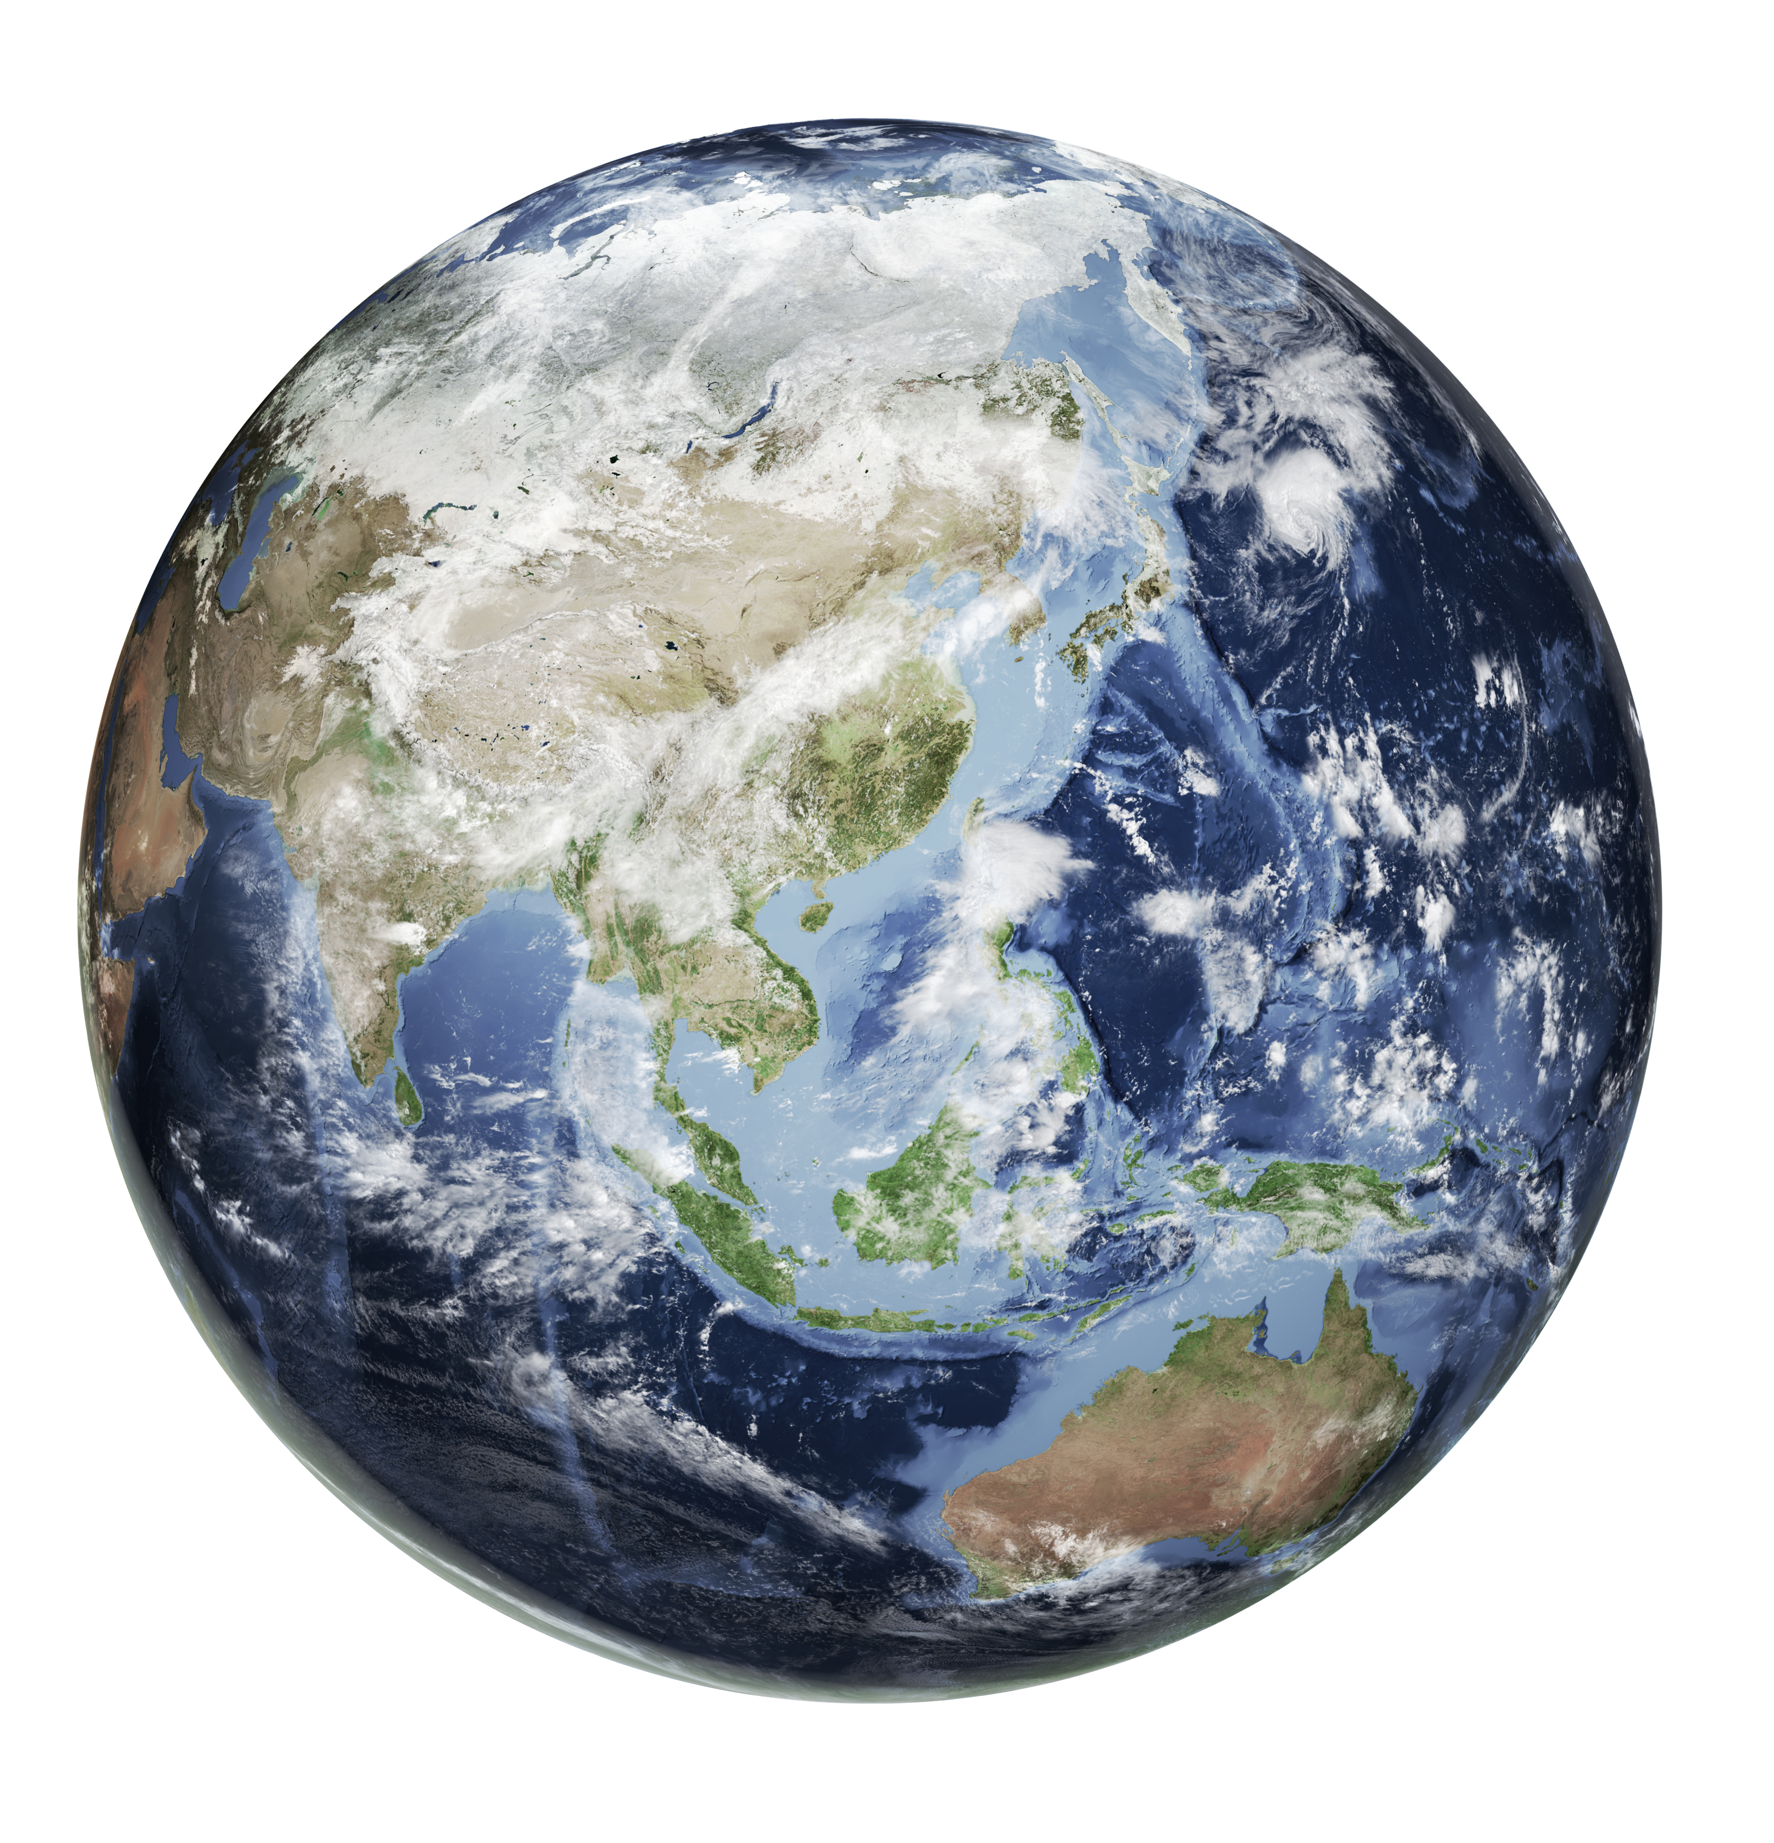




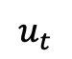
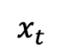
What is optimal control?
Optimal control is about 1) modeling part of the world and 2) interacting with that model
state
⇄
$$x_{t}$$
$$u_{t}$$
controls

Slide 4
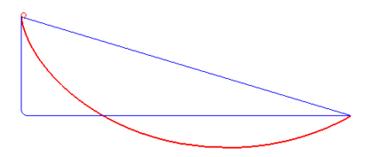
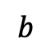
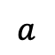
The brachistochrone problem
Johann Bernoulli, 1696
Optimal control is about 1) modeling part of the world and 2) interacting with that model
ball rolling down a ramp
shape of the ramp
$$a$$
fastest ramp
slower ramps
source
$$b$$
Source code examples in Dymos and APMonitor

Slide 5
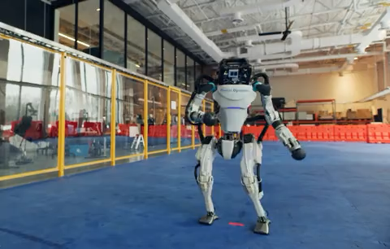
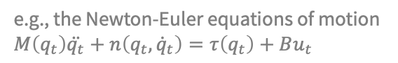
Optimal control in robotics
Optimal control is about 1) modeling part of the world and 2) interacting with that model
the robotic system
e.g., the Newton-Euler equations of motion $$M\left(q_{t}\right)\ddot{q_{t}}+n\left(q_{t},{\dot{q}}_{t}\right)=τ\left(q_{t}\right)+Bu_{t}$$
actuators
e.g., torques on the joints, thrusters, steering, acceleration, braking
Source: Boston Dynamics

Slide 6
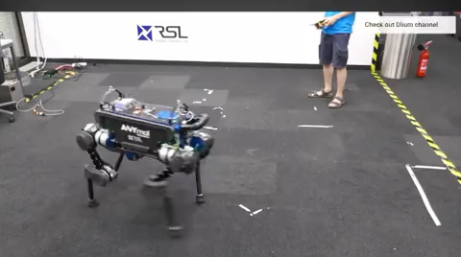
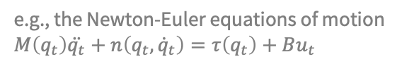
Optimal control in robotics
Optimal control is about 1) modeling part of the world and 2) interacting with that model
the robotic system
e.g., the Newton-Euler equations of motion $$M\left(q_{t}\right)\ddot{q_{t}}+n\left(q_{t},{\dot{q}}_{t}\right)=τ\left(q_{t}\right)+Bu_{t}$$
actuators
e.g., torques on the joints, thrusters, steering, acceleration, braking
Source
📚 Learning Agile and Dynamic Motor Skills for Legged Robots. Hwangbo et al., Science Robotics 2019.

Slide 7
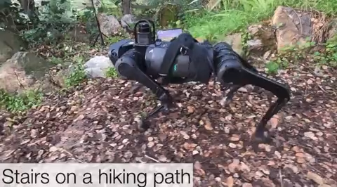
Optimal control in robotics
Optimal control is about 1) modeling part of the world and 2) interacting with that model
the robotic system
e.g., the Newton-Euler equations of motion $$M\left(q_{t}\right)\ddot{q_{t}}+n\left(q_{t},{\dot{q}}_{t}\right)=τ\left(q_{t}\right)+Bu_{t}$$
actuators
e.g., torques on the joints, thrusters, steering, acceleration, braking
Source
📚 RMA: Rapid Motor Adaptation for Legged Robots. Ashish Kumar et al., RSS 2021.

Slide 8
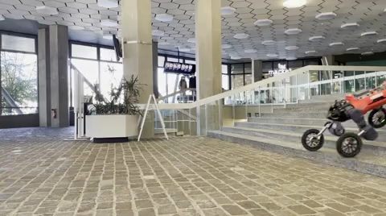
Optimal control in robotics
Optimal control is about 1) modeling part of the world and 2) interacting with that model
the robotic system
e.g., the Newton-Euler equations of motion $$M\left(q_{t}\right)\ddot{q_{t}}+n\left(q_{t},{\dot{q}}_{t}\right)=τ\left(q_{t}\right)+Bu_{t}$$
actuators
e.g., torques on the joints, thrusters, steering, acceleration, braking
Source
📚 Advanced skills through multiple adversarial motion priors in reinforcement learning. Vollenweider et al., ICRA 2023.

Slide 9
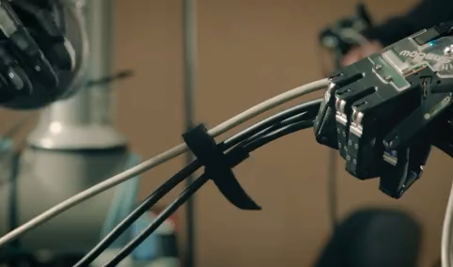
Optimal control in robotics
Optimal control is about 1) modeling part of the world and 2) interacting with that model
the robotic system
e.g., the Newton-Euler equations of motion $$M\left(q_{t}\right)\ddot{q_{t}}+n\left(q_{t},{\dot{q}}_{t}\right)=τ\left(q_{t}\right)+Bu_{t}$$
actuators
e.g., torques on the joints, thrusters, steering, acceleration, braking
Source: Shadow Robotics

Slide 10
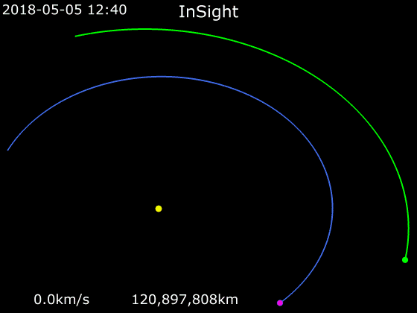
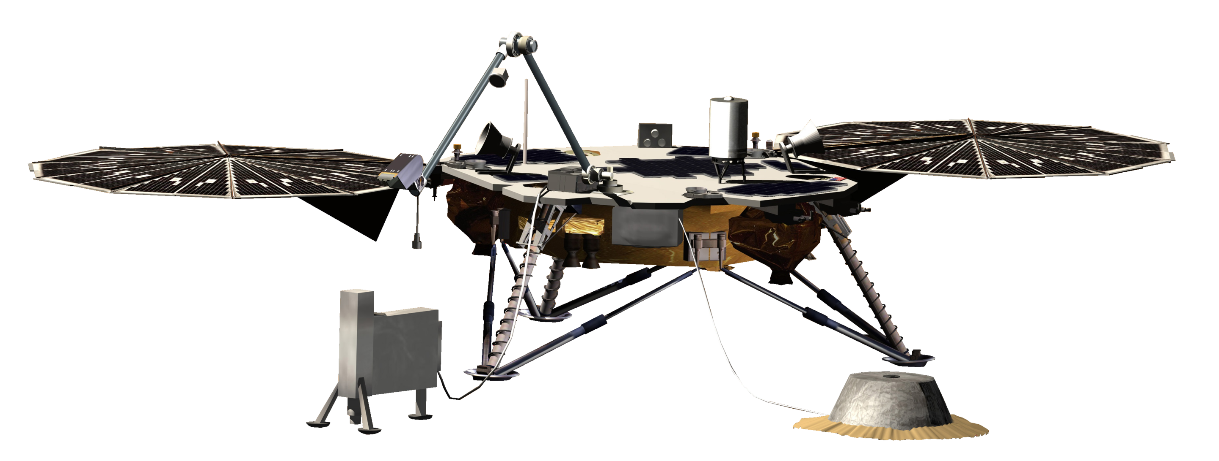
Optimal control in robotics
Optimal control is about 1) modeling part of the world and 2) interacting with that model
the robotic system
e.g., the Newton-Euler equations of motion $$M\left(q_{t}\right)\ddot{q_{t}}+n\left(q_{t},{\dot{q}}_{t}\right)=τ\left(q_{t}\right)+Bu_{t}$$
actuators
e.g., torques on the joints, thrusters, steering, acceleration, braking
Source
A Hohmann transfer orbit. See also:
📚 Dynamical Systems, the Three-Body Problem and Space Mission Design. Koon et al., 1999.

Slide 11
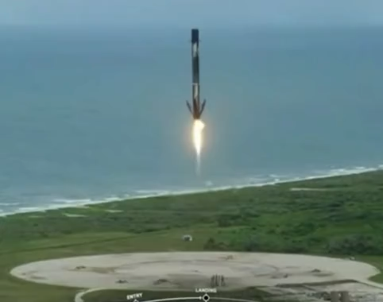
Optimal control in robotics
Optimal control is about 1) modeling part of the world and 2) interacting with that model
the robotic system
e.g., the Newton-Euler equations of motion $$M\left(q_{t}\right)\ddot{q_{t}}+n\left(q_{t},{\dot{q}}_{t}\right)=τ\left(q_{t}\right)+Bu_{t}$$
actuators
e.g., torques on the joints, thrusters, steering, acceleration, braking
Source
Source: SpaceX
📚 Convex Programming Approach to Powered Descent Guidance for Mars Landing. Açıkmeşe and Ploen, 2007.
📚 Minimum-landing-error powered-descent guidance for Mars landing using convex optimization. Blackmore et al., 2010.
📚 Lossless Convexification of Nonconvex Control Bound and Pointing Constraints of the Soft Landing Optimal Control Problem. Açıkmeşe et al., 2013.

Slide 12
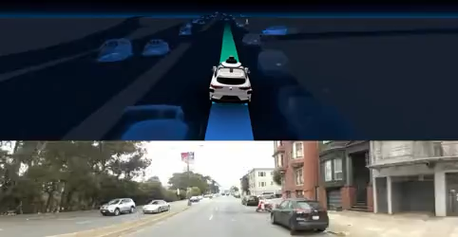
Optimal control in robotics
Optimal control is about 1) modeling part of the world and 2) interacting with that model
the robotic system
e.g., the Newton-Euler equations of motion $$M\left(q_{t}\right)\ddot{q_{t}}+n\left(q_{t},{\dot{q}}_{t}\right)=τ\left(q_{t}\right)+Bu_{t}$$
e.g., torques on the joints, thrusters, steering, acceleration, braking
actuators
Source
Source: Waymo
Source: SpaceX

Slide 13
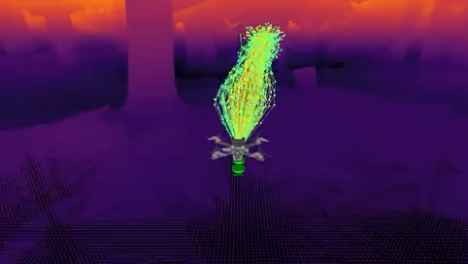
Optimal control in robotics
Optimal control is about 1) modeling part of the world and 2) interacting with that model
the robotic system
e.g., the Newton-Euler equations of motion $$M\left(q_{t}\right)\ddot{q_{t}}+n\left(q_{t},{\dot{q}}_{t}\right)=τ\left(q_{t}\right)+Bu_{t}$$
e.g., torques on the joints, thrusters, steering, acceleration, braking
actuators
Source
Source: SpaceX
Source
📚 Learning high-speed flight in the wild. Loquercio et al., Science Robotics 2021.

Slide 14
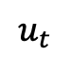
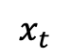
Where does machine learning fit in?
Optimal control is about 1) modeling part of the world and 2) interacting with that model
state
⇄
$$x_{t}$$
$$u_{t}$$
controls
Data
Machine learning (ML) is about using data to 1) create abstractions, and 2) make predictions
[ML$→$Control] learn how to model and interact with the world from data (e.g., reinforcement learning)
[Control$→$ML] interpret ML problems as control problems, solve with control methods
❗
e.g., RL from human feedback for language models

Slide 15
This talk: machine learning ⇄ optimal control
1. Modeling and learning dynamics
2. Machine learning for optimal control
+ Reinforcement learning (policy, value, and model learning)
+ Differentiable control
3. Optimal control for machine learning
+ Perspective on diffusion and optimal transport models
+ RL-based updates for machine learning models (e.g., RLHF)

Slide 16
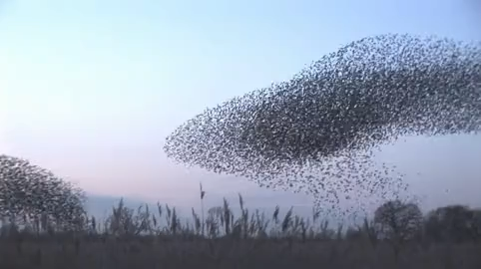
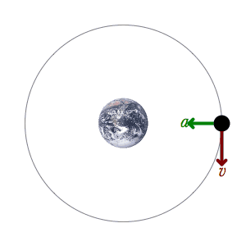
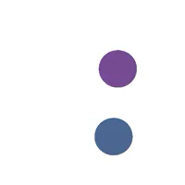
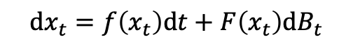
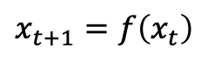
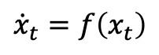
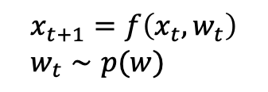
How do we (passively) model the world?
Mechanics is the paradise of the mathematical sciences, because by means of it one comes to the fruits of mathematics.
da Vinci (1459-1519), Notebooks, v. 1, ch. 20.
📚 Quote also given at the beginning of Geometric Control of Mechanical Systems, Bullo and Lewis, 2000.
1. Make observations
2. Come up with a theory
Source
Continuous time
Discrete time
$${\dot{x}}_{t}=f\left(x_{t}\right)$$
Deterministic
$$x_{t+1}=f\left(x_{t}\right)$$
e.g., differential equations (ODE/PDEs)
e.g., Turing machines, games
$$\text{d}x_{t}=f\left(x_{t}\right)\text{d}t+F\left(x_{t}\right)\text{d}B_{t}$$
$$x_{t+1}=f\left(x_{t}, w_{t}\right) \\ w_{t}∼p(w)$$
Source
Stochastic
📚 Learning Neural Event Functions for Ordinary Differential Equations. Ricky T. Q. Chen, Brandon Amos, Maximilian Nickel, ICLR 2021.
e.g., Markov chains
e.g., stochastic differential equations

Slide 17
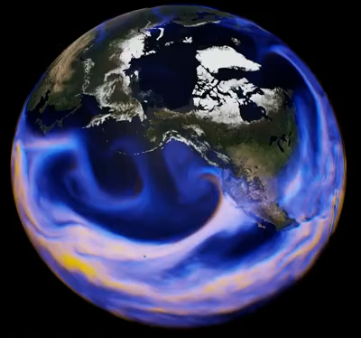
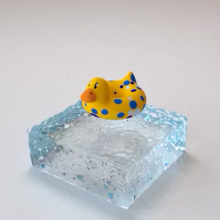
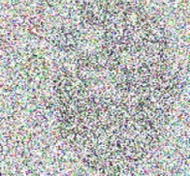
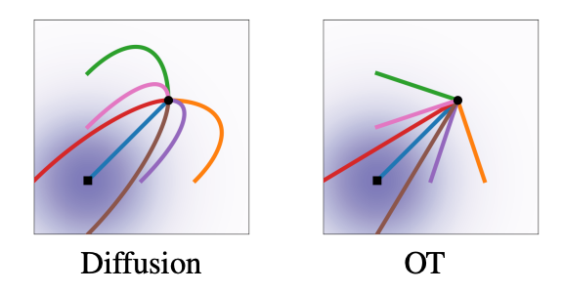
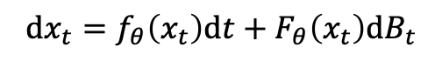
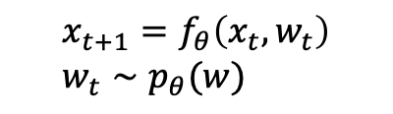
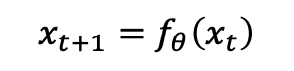
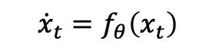
Machine learning way of learning dynamics
1. Collect data of the system
2. Throw neural networks at it
Continuous time
Discrete time
$${\dot{x}}_{t}=f_{θ}\left(x_{t}\right)$$
a neural network
a neural network
Deterministic
$$x_{t+1}=f_{θ}\left(x_{t}\right)$$
Source: NVIDIA
e.g., Neural ODEs/PDEs, neural operators
e.g., RNNs, LSTMs, Transformers for language and other discrete-time sequential data
📚 FourCastNet, Pathak et al., 2022.
📚 Learning Neural Constitutive Laws. Ma et al., ICML 2023.
$$\text{d}x_{t}=f_{θ}\left(x_{t}\right)\text{d}t+F_{θ}\left(x_{t}\right)\text{d}B_{t}$$
$$x_{t+1}=f_{θ}\left(x_{t}, w_{t}\right) \\ w_{t}∼p_{θ}(w)$$
neural networks
neural networks
Stochastic
e.g., RNNs with stochastic states
e.g., Neural SDEs, diffusion models, flow matching
📚 A Recurrent Latent Variable Model for Sequential Data. Chung et al., NeurIPS 2015.
📚 Sequential Neural Models with Stochastic Layers. Fraccaro et al., NeurIPS 2016.
📚 Deep unsupervised learning using nonequilibrium thermodynamics. Sohl-Dickstein et al., ICML 2015.
📚 Score-Based Generative Modeling through Stochastic Differential Equations. Song et al., ICLR 2021.
📚 Flow Matching for Generative Modeling. Lipman et al., ICLR 2023.
📚 Stochastic Interpolants. Albergo et al., ICLR 2023.

Slide 18
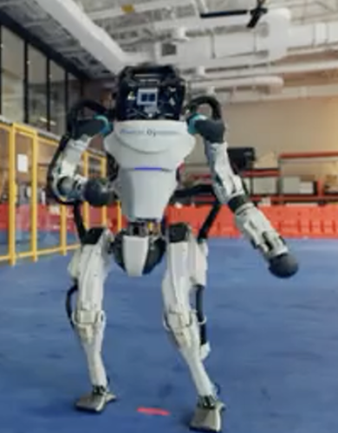
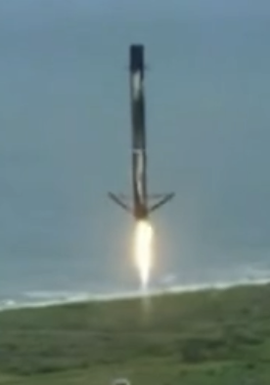
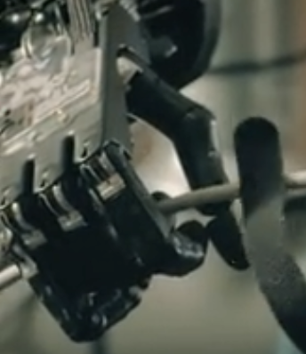
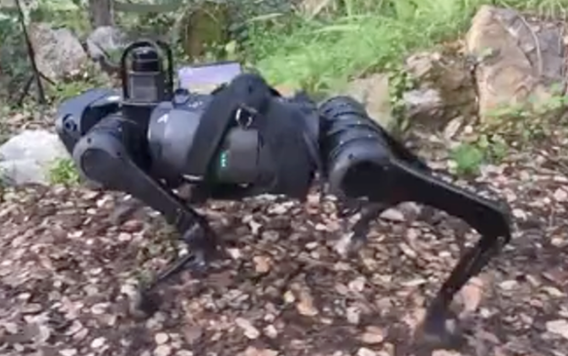
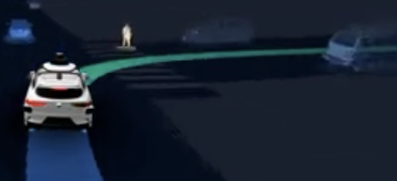
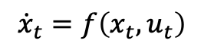
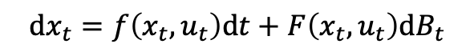
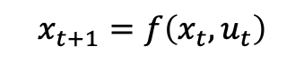
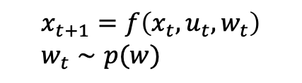
Adding interactions — controlled dynamics
state
⇄
$$x_{t}$$
$$u_{t}$$
controls
Continuous time
Discrete time
$${\dot{x}}_{t}=f\left(x_{t}, u_{t}\right)$$
Deterministic
$$x_{t+1}=f\left(x_{t}, u_{t}\right)$$
$$\text{d}x_{t}=f\left(x_{t}, u_{t}\right)\text{d}t+F\left(x_{t}, u_{t}\right)\text{d}B_{t}$$
$$x_{t+1}=f\left(x_{t}, u_{t}, w_{t}\right) \\ w_{t}∼p(w)$$
Stochastic
Notes:
Mention context

Slide 19
This talk: machine learning ⇄ optimal control
1. Modeling and learning dynamics
2. Machine learning for optimal control
+ Reinforcement learning (policy, value, and model learning)
+ Differentiable control
3. Optimal control for machine learning
+ Perspective on diffusion and optimal transport models
+ RL-based updates for machine learning models (e.g., RLHF)

Slide 20
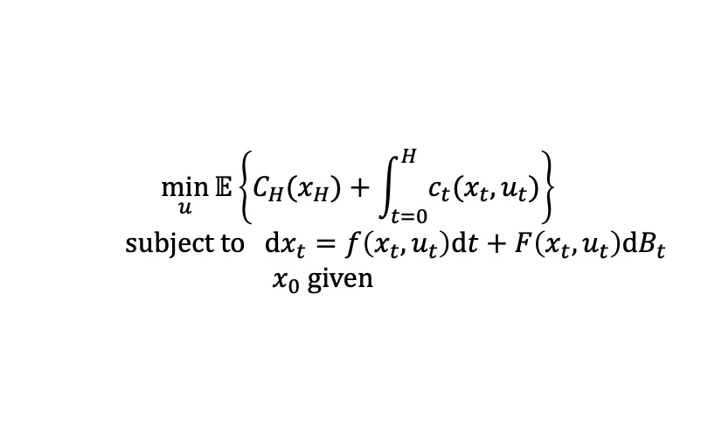
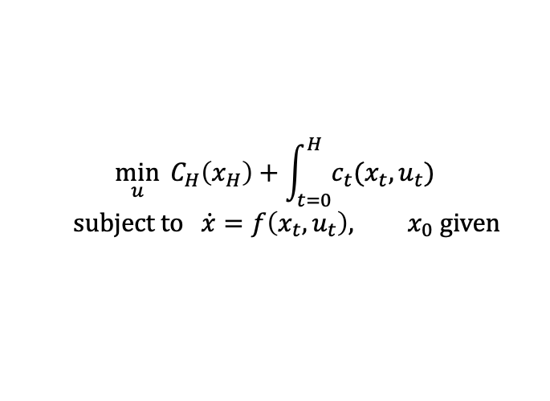
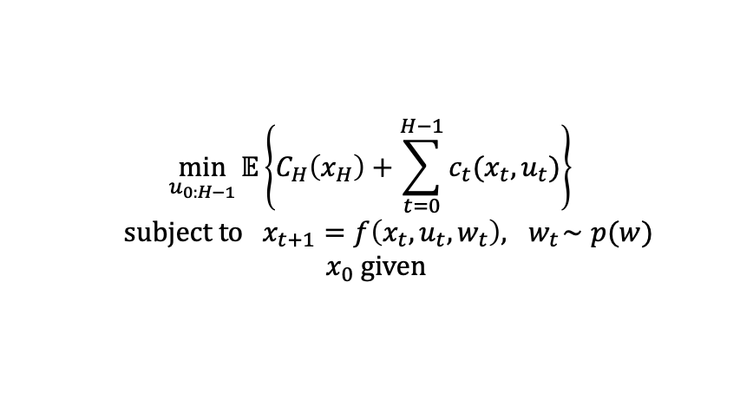
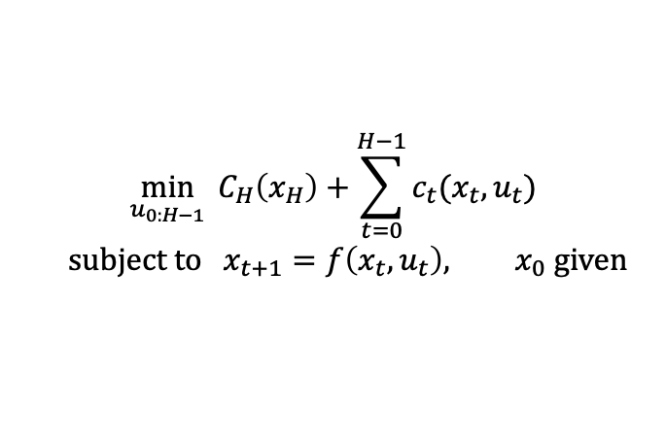
Formulating basic optimal control problems
*Can add many more constraints/variations
Optimal control is about 1) modeling part of the world and 2) interacting with that model
Continuous time
Discrete time
$$\min_{u}{ C_{H}\left(x_{H}\right)+\int_{t=0}^{H}{c_{t}(x_{t}, u_{t})}}$$
$$\text{subject} \text{to} \dot{x}=f\left(x_{t}, u_{t}\right), x_{0} \text{given}$$
$$\min_{u_{0:H−1}}{ C_{H}\left(x_{H}\right)+\sum_{t=0}^{H−1}{c_{t}(x_{t}, u_{t})}}$$
$$\text{subject} \text{to} x_{t+1}=f\left(x_{t}, u_{t}\right), x_{0} \text{given}$$
Deterministic
$$\min_{u}{𝔼\left\{C_{H}(x_{H})+\int_{t=0}^{H}{c_{t}(x_{t}, u_{t})}\right\}}$$
$$\text{subject} \text{to} \text{d}x_{t}=f\left(x_{t}, u_{t}\right)\text{d}t+F\left(x_{t}, u_{t}\right)\text{d}B_{t}$$
$$x_{0} \text{given}$$
$$\min_{u_{0:H−1}}{𝔼\left\{C_{H}\left(x_{H}\right)+\sum_{t=0}^{H−1}{c_{t}(x_{t}, u_{t})}\right\} }$$
$$\text{subject} \text{to} x_{t+1}=f\left(x_{t}, u_{t}, w_{t}\right),{ w}_{t}∼p(w)$$
$$x_{0} \text{given}$$
Stochastic

Slide 21
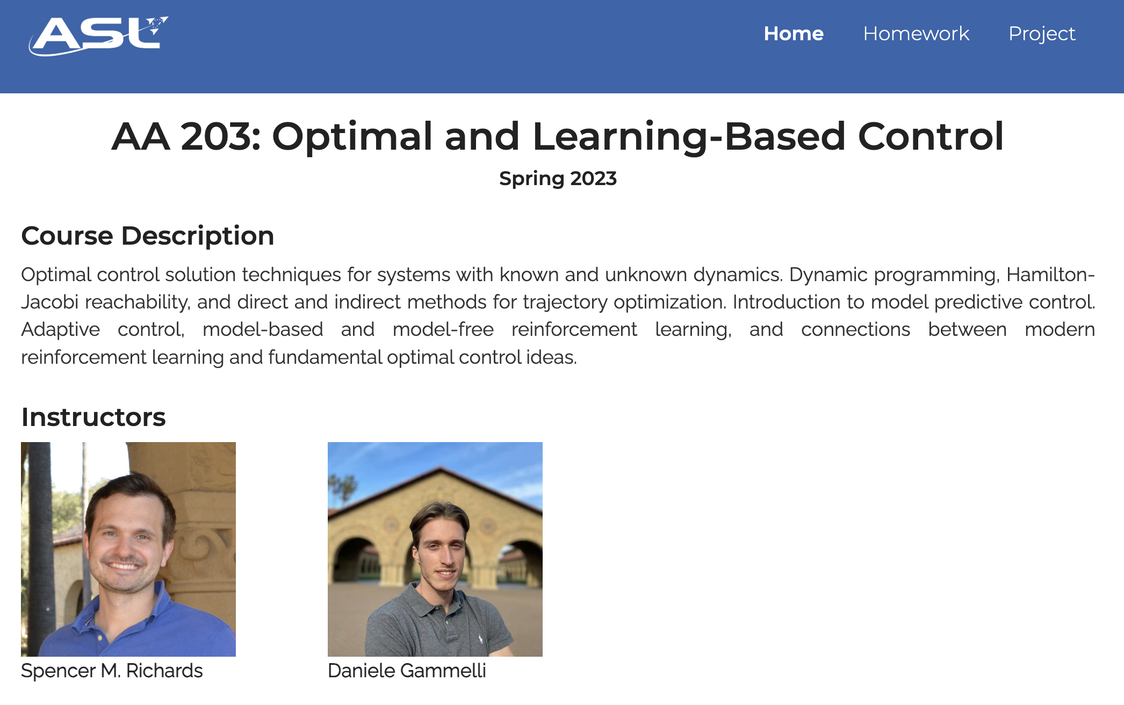

Solving optimal control problems
at Stanford

Slide 22

Analyzing controllers
at Stanford

Slide 23

Analyzing controllers
at Stanford

Slide 24





Other optimal control courses & books
Adaptive and nonlinear control, Maxim Raginsky [UIUC ECE 517]
SDEs in Optimization, Control, and Learning, Maxim Raginsky [UIUC ECE 586]
Robotic manipulation, Russ Tedrake [MIT 6.4210]
Underactuated robotics, Russ Tedrake [MIT 6.8210]
Optimal control, Zac Manchester [CMU 16-745]
Optimal and Learning-Based Control, Spencer M. Richards and Daniele Gammelli [Stanford AA 203]
… and many others

Slide 25



Optimal control as a function
(no learning yet, all optimization)
$$\underset{u_{0:H−1}}{argmin}{ C_{H}\left(x_{H}\right)+\sum_{t=0}^{H−1}{c_{t}(x_{t}, u_{t})}}$$
$$\text{subject} \text{to} x_{t+1}=f\left(x_{t}, u_{t}\right)$$
$$x, c_{t}, C_{h}, f$$
$$π(x;c_{t}, C_{H}, f)$$

Slide 26


Where does machine learning fit in?
$$\frac{∂}{∂f}π(x)$$
differentiable control
cost learning
$$\underset{u_{0:H−1}}{argmin}{ C_{H}\left(x_{H}\right)+\sum_{t=0}^{H−1}{c_{t}(x_{t}, u_{t})}}$$
$$\text{subject} \text{to} x_{t+1}=f\left(x_{t}, u_{t}\right)$$
value learning
$$x, c_{t}, C_{h}, f$$
$$π(x;c_{t}, C_{H}, f)$$
policy learning
(amortized optimization)
dynamics learning
Reinforcement learning (/approximate dynamic programming) usually value and policy learning, especially when $f$ is unknown

Slide 27


Markov decision processes and RL
A Markov decision process (MDP) is a stochastic control process:
State space $𝒳$, control space $𝒰$
Transition dynamics $f\left(x, u\right)$
Reward function $r\left(x, u\right)$
A policy $π:𝒳→𝒰$ maps a state to a reward.
Goal: find the optimal policy to maximize the value

Slide 28







Comparing the MDP to optimal control
MDPs focus strongly on infinite horizon/time-invariant policies $π\left(x\right)$
May not exist for all OC problems
MDPs usually more difficult to add constraints/extra terms to
E.g., goal conditioning or time-varying constraints
Optimal control (open-loop)
MDP policies (and closed loop control)
$$π(x)$$
$$\min_{u}{ \int_{t=0}^{H}{{\left\|x_{t}−B\right\|}^{2}}}$$
$$\text{subject} \text{to} \dot{x}=f\left(x_{t}, u_{t}\right), x_{0}=A$$
$$\min_{θ}{𝔼 Q(x, π_{θ}\left(x\right))}$$
📚 An Introduction to Trajectory Optimization: How to Do Your Own Direct Collocation. Matthew Kelley, SIAM Review, 2017.

Slide 29





Repeatedly optimizing for computing a policy
$$π\left(x\right)=\underset{u}{argmax}\left\{Q\left(x,u\right)≔r\left(x, u\right)+𝔼 V\left(x^{′}\right)\right\}$$
$$π\left(x_{1}\right)$$
$$π\left(x_{6}\right)$$
$$π\left(x_{12}\right)$$
value
action
action
action

Slide 30


Policy learning and amortized optimization
📚 Continuous control with deep reinforcement learning. Lillicrap et al., ICLR 2016. 📚 Learning Continuous Control Policies by Stochastic Value Gradient. Heess et al., NeurIPS 2015.
📚 Tutorial on amortized optimization for learning to optimize over continuous domains. Amos, Foundations and Trends in Machine Learning 2023.
Independently solve
Learn a policy to predict the solution
$$π\left(x\right)=\underset{u}{argmax}{Q(x, u)}$$
$$\underset{θ}{argmax}{𝔼_{p\left(x\right)} Q(x, π_{θ}\left(x\right))}$$

Slide 31


Further reading on amortized optimization
Reinforcement learning and control (actor-critic methods, SAC, DDPG, GPS, BC)
Variational inference (VAEs, semi-amortized VAEs)
Meta-learning (HyperNets, MAML)
Sparse coding (PSD, LISTA)
Roots, fixed points, and convex optimization (NeuralDEQs, RLQP, NeuralSCS)
Optimal transport (slicing, conjugation, Meta Optimal Transport)

Slide 32




Model-based stochastic value gradients
📚 Learning Continuous Control Policies by Stochastic Value Gradient. Heess et al., NeurIPS 2015. 📚 Imagined value gradients. Byravan et al., CoRL 2020.
📚 On the model-based stochastic value gradient for continuous reinforcement. B. Amos et al., L4DC 2021.
cost learning
$$\underset{u_{0:H−1}}{argmin}{ C_{H}\left(x_{H}\right)+\sum_{t=0}^{H−1}{c_{t}(x_{t}, u_{t})}}$$
$$\text{subject} \text{to} x_{t+1}=f\left(x_{t}, u_{t}\right)$$
value learning
dynamics learning
$$π(x;c_{t}, C_{H}, f)$$
policy learning
Notes:
TODO: safety/generalization

Slide 33



Diffusion for control and RL
📚 Planning with Diffusion for Flexible Behavior Synthesis. Janner*, Du*, et al., ICML 2022.
📚 Is Conditional Generative Modeling all you need for Decision-Making? Ajay*, Du* et al., ICML 2023.
Predicting 1) dynamics, 2) rewards, and 3) optimal trajectories/policies

Slide 34



Reinforcement learning topics

Slide 35





Control & reinforcement learning resources
1. A Tour of Reinforcement Learning: The View from Continuous Control. Benjamin Recht, 2019.
2. Deep Reinforcement Learning. Sergey Levine. [Berkeley CS 285]
3. Reinforcement learning. David Silver [UCL]
4. Deep Reinforcement Learning. Katerina Fragkiadaki [CMU 10-703]

Slide 36
This talk: machine learning ⇄ optimal control
1. Modeling and learning dynamics
2. Machine learning for optimal control
+ Reinforcement learning (policy, value, and model learning)
+ Differentiable control
3. Optimal control for machine learning
+ Perspective on diffusion and optimal transport models
+ RL-based updates for machine learning models (e.g., RLHF)

Slide 37






Controllers don’t live in isolation
We can often measure the downstream performance induced by the controller
Idea: optimize (i.e., tune/learn) the parameters for a downstream performance metric
Controller-design loop is not a new idea and has been extensively used over the past century
$$θ$$
controller parameters
(design space of cost and model)
solve control optimization problem
cost
initial state
dynamics
constraints
$${x_{1:T}^{⋆}, u}_{1:T}^{⋆}∈\underset{{x_{1:T}, u}_{1:T}}{argmin}{ \sum_{t}{C_{θ}\left(x_{t}, u_{t}\right)}} \text{s}\text{.}\text{t}\text{. }x_{1}=x_{\text{init}} x_{t+1}=f_{θ}\left(x_{t}, u_{t}\right) u_{t}∈𝒰$$
Full notation: $u_{1:T}^{⋆}(x_{\text{init}}, θ)$
$$π_{θ}\left(x\right)≝u_{1}^{⋆}(x, θ)$$
execute control policy on the system
$$𝒥(π_{θ})$$
measure downstream performance of the controller

Slide 38


Differentiate the controller!
We can often measure the downstream performance induced by the controller
Idea: optimize (i.e., tune/learn) the parameters for a downstream performance metric
by differentiating through the control optimization problem
$$θ$$
controller parameters
(design space of cost and model)
solve control optimization problem
cost
initial state
dynamics
constraints
$${x_{1:T}^{⋆}, u}_{1:T}^{⋆}∈\underset{{x_{1:T}, u}_{1:T}}{argmin}{ \sum_{t}{C_{θ}\left(x_{t}, u_{t}\right)}} \text{s}\text{.}\text{t}\text{. }x_{1}=x_{\text{init}} x_{t+1}=f_{θ}\left(x_{t}, u_{t}\right) u_{t}∈𝒰$$
differentiable control
$$∇_{θ}𝒥\left(π_{θ}\right)$$
or ${\text{D}}_{θ}\left(π_{θ}(x)\right)$
Full notation: $u_{1:T}^{⋆}(x_{\text{init}}, θ)$
$$π_{θ}\left(x\right)≝u_{1}^{⋆}(x, θ)$$
execute control policy on the system
$$𝒥(π_{θ})$$
measure downstream performance of the controller

Slide 39





Derivatives in RL and control
The policy (or value) gradient Derivative of value w.r.t. a parameterized policy:
$$∇_{θ}𝔼_{x_{t} }[Q\left(x_{t}, π_{θ}\left(x_{t}\right)\right)]$$
For policy learning via amortized optimization
$Q$-value can be model-based or model-free
Works for deterministic and stochastic policies
Differentiable control
Derivative of actions w.r.t. controller parameters:
$$∂u_{1:T}^{⋆}(θ)/∂θ$$
Controller induces a model-based policy
$$u^{⋆}\left(θ\right)$$
$$u$$
$$θ$$
Each vertical slice is a control problem

Slide 40
How to differentiate the controller?
📚 Differentiable MPC. Amos et al., NeurIPS 2018; Differentiable convex optimization layers. Agrawal*, Amos*, et al., NeurIPS 2019; The differentiable cross-entropy method. ICML 2020; Learning Convex Optimization Control Policies, Agrawal* et al., L4DC 2020.
Unrolling or autograd
Idea: Implement controller, let autodiff do the rest
Like MAML’s unrolled gradient descent
Ideal when unconstrained with a short horizon
Does not require a fixed-point or optimal solution
Instable and resource-intensive for large horizons
Can unroll algorithms beyond gradient descent
The differentiable cross-entropy method
Implicit differentiation
Idea: Differentiate controller’s optimality conditions
Agnostic of the control algorithm
Ill-defined if controller gives suboptimal solution
Memory and compute efficient: free in some cases
$$D_{θ}u^{⋆}\left(θ\right)=−D_{u}g{\left(θ,u^{⋆}\left(θ\right)\right)}^{−1}D_{θ}g\left(θ, u^{⋆}\left(θ\right)\right)$$

Slide 41





End-to-end model learning starting references
… among many others!

Slide 42
This talk: machine learning ⇄ optimal control
1. Modeling and learning dynamics
2. Machine learning for optimal control
+ Reinforcement learning (policy, value, and model learning)
+ Differentiable control
3. Optimal control for machine learning
+ Perspective on diffusion and optimal transport models
+ RL-based updates for machine learning models (e.g., RLHF)

Slide 43


Euclidean distance as optimal control
📚 On the relation between optimal transport and Schrödinger bridges: A stochastic control viewpoint. Chen et al., 2016. (Section II.B)

Slide 44





Optimal control for optimal transport
📚 On the relation between optimal transport and Schrödinger bridges: A stochastic control viewpoint. Chen et al., 2016
(Entropic) optimal transport path stochastic optimal control between two measures
Euclidean path optimal control between two points
📚 Deep Generalized Schrödinger Bridge. Liu et al., NeurIPS 2022.
📚 Likelihood Training of Schrödinger Bridge using Forward-Backward SDEs Theory. Chen*, Liu*, and Theodorou, ICLR 2022.
Notes:
`

Slide 45

Optimal control+RL for solving QPs
📚Accelerating quadratic optimization with reinforcement learning. Ichnowski et al., NeurIPS 2021.
Optimal control is about 1) modeling part of the world and 2) interacting with that model
Solving a quadratic program
Solver parameters during training

Slide 46


Reinforcement learning from human feedback
📚 Deep reinforcement learning from human preferences. Christiano et al., NeurIPS 2017; Fine-tuning language models from human preferences. Ziegler et al., 2019. Learning to summarize with human feedback. Stiennon et al., NeurIPS 2020. Training language models to follow instructions with human feedback. Ouyang et al., NeurIPS 2022.
Optimal control is about 1) modeling part of the world and 2) interacting with that model
language preferences
a language model

Slide 47




Ongoing and future directions in ML+control
Modeling and controlling isolated systems is relatively well-understood
Challenge: understanding and interacting with other parts of the world
Use language to specify tasks, goals, actions
📚 VIMA: General Robot Manipulation with Multimodal Prompts. Jiang et al., ICML 2023
📚 RoCo: Dialectic Multi-Robot Collaboration with Large Language Models. Zhao et al., 2023.
📚 RoCo: Dialectic Multi-Robot Collaboration with Large Language Models. Zhao et al., 2023.
📚 VIMA: General Robot Manipulation with Multimodal Prompts. Jiang et al., ICML 2023

Slide 48


Ongoing and future directions in ML+control
Modeling and controlling isolated systems is relatively well-understood
Challenge: understanding and interacting with other parts of the world
Use language to specify tasks, goals, actions
📚 VIMA: General Robot Manipulation with Multimodal Prompts. Jiang et al., ICML 2023
📚 RoCo: Dialectic Multi-Robot Collaboration with Large Language Models. Zhao et al., 2023.
Incorporating non-trivial geometries and terrains
📚 TAMOLS: Terrain-Aware Motion Optimization for Legged Systems. Jenelten et al., Transactions on Robotics, 2022.
📚 Vision-only robot navigation in a neural radiance world. Adamkiewicz et al., IEEE Robotics and Automation Letters 2022.
📚 SNeRL: Semantic-aware Neural Radiance Fields for Reinforcement Learning. Shim*, Lee*, and Kim, ICML 2023.

Slide 49

Ongoing and future directions in ML+control
Modeling and controlling isolated systems is relatively well-understood
Challenge: understanding and interacting with other parts of the world
Use language to specify tasks, goals, actions
📚 VIMA: General Robot Manipulation with Multimodal Prompts. Jiang et al., ICML 2023
📚 RoCo: Dialectic Multi-Robot Collaboration with Large Language Models. Zhao et al., 2023.
Incorporating non-trivial geometries and terrains
📚 TAMOLS: Terrain-Aware Motion Optimization for Legged Systems. Jenelten et al., Transactions on Robotics, 2022.
📚 Vision-only robot navigation in a neural radiance world. Adamkiewicz et al., IEEE Robotics and Automation Letters 2022.
📚 SNeRL: Semantic-aware Neural Radiance Fields for Reinforcement Learning. Shim*, Lee*, and Kim, ICML 2023.
Learning control-aware dynamics (task-oriented, decision-focused)
📚 Objective Mismatch in Model-based Reinforcement Learning. Lambert et al., L4DC 2020.
📚 Temporal Difference Learning for Model Predictive Control. Hansen et al., ICML 2022.
📚 Learning Control-Oriented Dynamical Structure from Data. Richards et al., ICML 2023.

Slide 50


Ongoing and future directions in ML+control
Modeling and controlling isolated systems is relatively well-understood
Challenge: understanding and interacting with other parts of the world
Use language to specify tasks, goals, actions
📚 VIMA: General Robot Manipulation with Multimodal Prompts. Jiang et al., ICML 2023
📚 RoCo: Dialectic Multi-Robot Collaboration with Large Language Models. Zhao et al., 2023.
Incorporating non-trivial geometries and terrains
📚 TAMOLS: Terrain-Aware Motion Optimization for Legged Systems. Jenelten et al., Transactions on Robotics, 2022.
📚 Vision-only robot navigation in a neural radiance world. Adamkiewicz et al., IEEE Robotics and Automation Letters 2022.
📚 SNeRL: Semantic-aware Neural Radiance Fields for Reinforcement Learning. Shim*, Lee*, and Kim, ICML 2023.
Learning control-aware dynamics (task-oriented, decision-focused)
📚 Objective Mismatch in Model-based Reinforcement Learning. Lambert et al., L4DC 2020.
📚 Temporal Difference Learning for Model Predictive Control. Hansen et al., ICML 2022.
📚 Learning Control-Oriented Dynamical Structure from Data. Richards et al., ICML 2023.
📚 Nocturne: a driving benchmark for multi-agent learning. Vinitsky et al., NeurIPS Datasets and Benchmarks 2022
Multi-agent control and game theory

Slide 51


Optimal control and societal challenges

Slide 52
This talk: machine learning ⇄ optimal control
1. Modeling and learning dynamics
2. Machine learning for optimal control
+ Reinforcement learning (policy, value, and model learning)
+ Differentiable control
3. Optimal control for machine learning
+ Perspective on diffusion and optimal transport models
+ RL-based updates for machine learning models (e.g., RLHF)

Slide 53
On optimal control and machine learning
Tutorial at the Workshop on New Frontiers in Learning, Control, and Dynamical Systems
Brandon Amos • Meta AI (FAIR) NYC
slides
github.com/bamos/presentations

